Slide 1
Subluxation and dislocation

Slide 2
subluxation
Definition:
It is define as a partial or incomplete dislocation of joint or organ , it is significant structural displacement .

Slide 4
Luxation (dislocation)
Definition :
It is define as a complete dislocation or displacement of a bone from it is natural position in the joint.

Slide 5
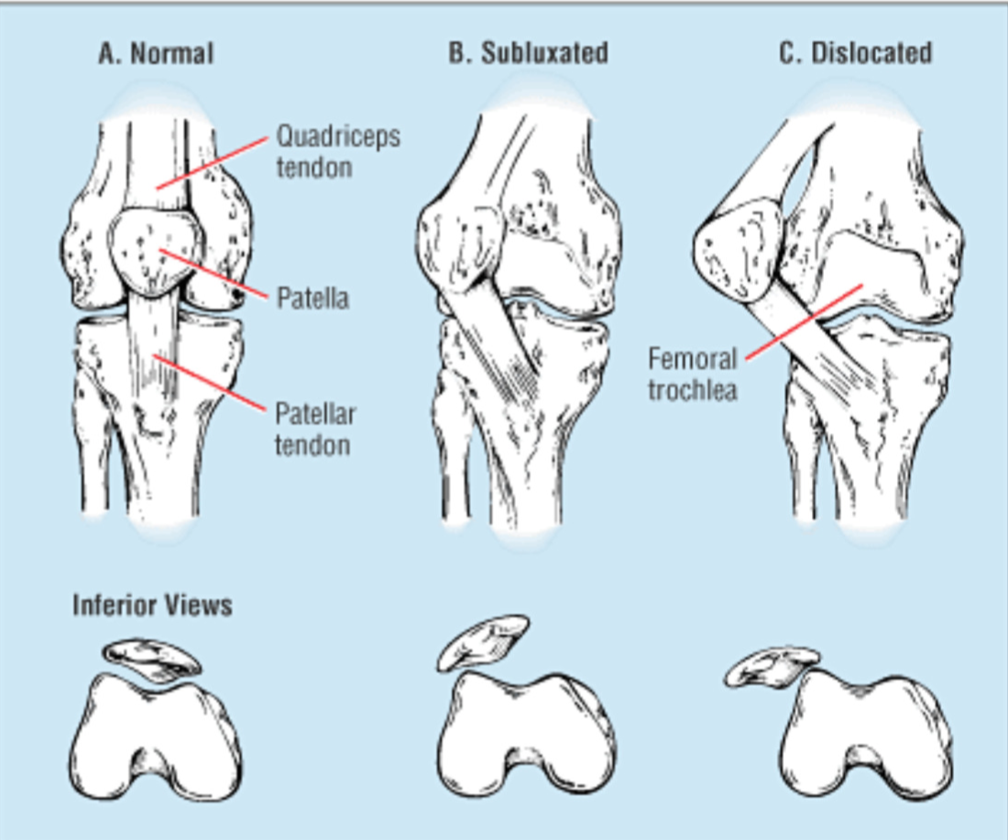

Slide 6
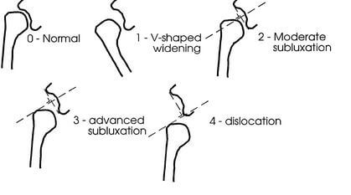

Slide 7
reasons of dislocations and subluxations
Altered muscle tone.
Impaired proprioception.
Repeated overstretching.
The shape of joint surfaces.
Traumatic incident.

Slide 8
Altered muscle tone
Inappropriate muscle patterning, in which certain muscles around a joint when they shouldn’t and then inappropriately work way too hard, can often pull a joint out of place. The joint is also easier to slip out, of course, if it is more lax in the first place. Muscle fatigue, spasms and stress can all play a part in this too.

Slide 9
Impaired proprioception
Proprioception is the body’s ability to sense position and movement within joints and enables us to know where our limbs are in space without us looking. It relates to coordination. Impaired joint position sense can cause joints to slip out of place

Slide 10
Repeated overstretching
Repeated overstretching to that degree will only exacerbate the laxity and the chances of the joints slipping out of place. Excessive exercise especially in racehorse cause overstretching of muscle and tendon, these lead to tension on joint and decreased the laxity of it and as a result of these stretching cause slipping the joint out of place

Slide 11
The shape of joint surfaces
Some of animal may be born with shallow-shaped joint sockets or other bony shaped anomalies that predispose a joint to possibly slipping out of position more easily. Unfortunately, that just may happen to be the shape of your skeleton.

Slide 12
Traumatic incident
Traumatic incidents can happen to anyone, but your extra joint laxity may actually work a little in your favor with this one; it may prevent you damaging some of your ligaments and tissues in the way that a non-hypermobile animal who suffered a traumatic dislocation probably.

Slide 13
There are six key principles that suggested for start incorporating to begin to get a grip on managing this situation (subluxation and luxation), as opposed to this situation managing. The main aims of keys are to 1- stay calm, 2- keep on top of the pain, and 3- allow the muscles to relax.

Slide 14
Principle management for sub & luxation
Breath
Use painkillers
Support the joint
Try heat
Distraction
Gentle massage

Slide 15
breathing
Use slow deep, relaxed breaths. Try using some relaxation techniques, there are lots of different ones out there. As painful as it is, and as difficult as it may sound, you need to start to try to take control of this situation. So start to learn how to breathe through it.

Slide 16
Use painkillers
Take some appropriate painkillers (analgesia) if you have some. However, You should only ever take analgesia according to the dosage indicated by your prescriber. Never take more than the suggested dose. You might feel like it may not be enough at the time, but if it can take some of the edge off, then that’s a great start. Please don’t ever overdose.

Slide 17
Support the joint
You need to try to make yourself as comfortable as possible (I know it’s not easy). Use pillows or a sling if you have one. Find a comfortable resting position as much as possible. This allows the muscles to relax and stop spasming.

Slide 18
Try heat
Hot water bottles, wheat bags, and a warm bath can all help to relax spasming, overactive muscles.

Slide 19
Distraction
Try to take your focus away from the pain and the situation. This can be helpful as a short-term pain relieving strategy. Again it can help muscles relax.

Slide 20
Gentle massage
Sometimes gentle massage around the joint can help relax the muscles enough to be able to gently relocate the joint or for the joint to just slip back into place by itself.

Slide 21
Prevention is better than cure! It is obviously better if we can prevent these situations occurring in the first place as opposed to having to deal with them. To that end, the following can hopefully help to reduce the frequency of such occurrences:
Physical therapy to learn to control the muscles around joints and to use the right ones.
Rehab to improve proprioception.
The possible use of supports/braces if required.
Trying to manage stress and anxieties.

Slide 22
Patellar luxation
causes a significant gait deficit, which brings it to the attention of the veterinarian early in the course of disease. It may be a congenital condition associated with malformation of the femoropatellar joint most commonly hypoplasia or osteochondrosis of the lateral trochlea. A femoral nerve deficit is associated with difficult parturition, especially breech presentation, and will present with a similar gait deficit because of the loss of quadriceps function. Additionally, loss of normal quadriceps muscle activity coupled with the normal lateral pull of the gluteobiceps muscle may also result in lateral patellar luxation. Finally, direct trauma to the stifle joint that tears the femoropatellar ligaments or calluses, a distal femoral fracture may also result in patellar luxation.

Slide 23
CLINICAL PRESENTATION AND DIAGNOSIS
Affected calves are unable to extend the stifle joint.
The pelvis is lowered on the affected side.
The animal is able to bear weight.
Cannot normally extend the stifle.
The animal prefers to lie down.
weaker calves will be unable to rise without assistance.
Even calves with bilateral disease are often able to stand and be somewhat ambulatory.

Slide 25
CLASSIFICATION OF PATELLAR LUXATION
In small animals, the patellar luxation's are classified from I to IV. The following classification modification is proposed for farm animals:
I. Intermittent patellar luxation causes the calf to
crouch occasionally on the affected limb while the animal walks. The patella easily luxates manually at full extension of the stifle joint, but returns to the trochlea when released.

Slide 26
II. The animal is capable of full stifle extension most times. On physical examination, the patella can be easily luxated manually at full extension and does not readily return to normal position.
III. The patella is permanently luxated. The animal is unable to extend the stifle, so it walks in a crouch position. During physical examination, one can reposition the patella, but it does not stay in place when the joint is flexed. The depth of the trochlear groove vanes.

Slide 27
IV. The patella is permanently luxated. The animal is unable to extend the stifle, so it walks in a crouch position. During physical examination, one cannot reposition the patella. Radiographically, the trochlear groove is flat or absent, and the lateral trochlea has been deformed by the overlying patella

